Slide 1

PROJECT B
PROJECT TITLE:PATAHOSTEL
PRESENTER:JAMES ALVINE
REGNO: SCEE/02768/2019
DATE:22/06/2023

Slide 2
INTRODUCTION
Patahostel is web platform that will be designed specifically for students where they can search for available hostel room(s) and accommodation services.
The beautify of this platform is that it helps students more so those new to a given county get their desired hostels directions through the use of geolocator and google navigator which students will find it easy for them to get to their desired hostels.

Slide 3
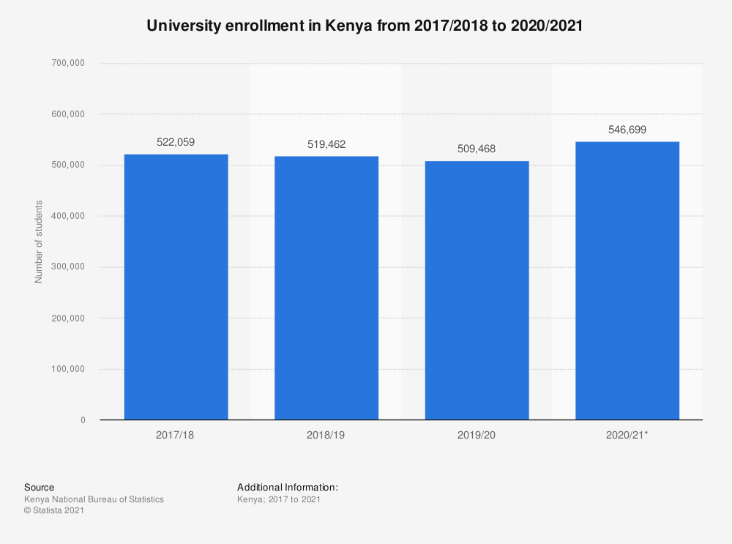
BACKGROUND STUDY

Slide 4
PROBLEM STATEMENT
With the increased number of students admitted annually, the number of students in need of hostels has also increased making it difficult to get hostel from the institution they have been admitted to. (Hostels a big problem in higher education - The Citizen March 6, 2022).A student who is new in town will end up stressed and confused not knowing where to start from

Slide 5
OBJECTIVES
General objectives
To enable students search for their preferred hostel
To register Agents in search for hostel
Specific objectives
To connect students and hostel agents/landlords easily.
To Create a web form that will capture details such as Name, email for the Agent
To give location for the desired chosen hostel
Allow students to register and view hostel details

Slide 6
SCOPE
The proposed system will be able to do the following:
Allow other hostel to market their services.
Use location feature to get the listed hostel.
Show the user available hostel in his/her region.
Provide more details about hostels e.g., the security of the hostel.
Allow interested students to communicate with the landlord/landlady.

Slide 7
JUSTIFICATION
The project will be of much importance to university and college students as it uses it will use google maps to get to know the location of the chosen hostel, another thing to add on, patahosetel will host hostel services for other counties in Kenya.
There will be need to include how each hostel are rated so that students can decide which hostel to go for.

Slide 8
COST/REQUIREMENTS
ITEM | COST(Ksh.) | QUANTITY | TOTAL COAST (Ksh.) | AVAILABILITY
Laptop | 35,000 | 1 | 35000 | available
Internet bundles plan | 1500 |  | 1500 | available
Mobile phone | 15,000 | 1 | 15000 | available
Total cost |  |  | 51,000

Slide 9
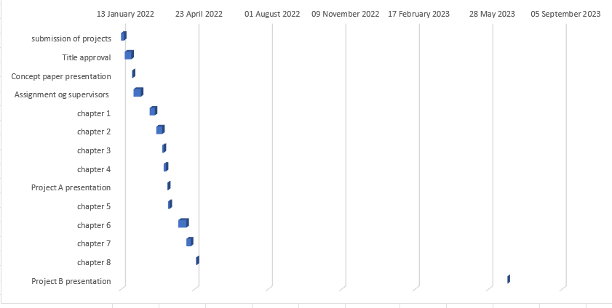
PROJECT SCHEDULE
Gantt chart

Slide 10
LITERATURE REVIEW
Qwetu Hostel
Qwetu Residences are home to more than 3800 students and who get to study, learn and connect with friends and peers. With six residences which are currently operational, Qwetu is the only
Private student accommodation provider in Kenya, the residences are fully equipped to host students during their campus life! (Most preferred student accommodation in Nairobi - Qwetu.co.ke n.d.).
This system favors students available in Nairobi County, the website allows user to key in their details and apply for the available room, thereafter, the user will have to choose the type of room, Qwetu hostel has one of the best luxurious hostels found in Nairobi.
Vuno kejani
Vuno kejani is a hostel searching platform Kenya. It was founded in 2021 and has helped students from various higher learning institutions find a hostel near the institution that they are learning in. They link up students with agents of various hostels through a user-friendly platform. Once you have found a hostel you want to live in, you will contact the agent on the property page. You will send your Email Address and a contact number from which you will be called.
. (Vuno Kejani March 10, 2022).

Slide 11
LITERATURE REVIEW cont.
Roometo
Roometo is an online platform that specializes in student accommodation. It helps students, both in college and university, find an alternative place to stay. It also provides recommendations and reviews, a way for them to ensure their users settle for the most affordable, secure and comfortable place.
And so, in 2017 they decided to do something about it. It took a few months for them to come up with the first iteration and test it out. It was simple for them, one would simply fill a form expressing interest in a hostel and we would follow up with phone calls March 10, 2022).

Slide 12
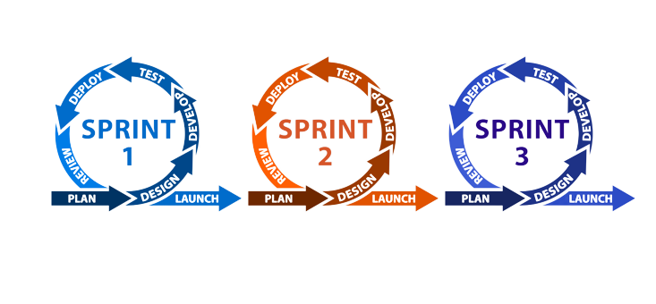
METHODOLOGY/DEVELOPMENT TOOLS
This methodology will also help the project since it relies on incremental developments, where the goal of each sprint is to build the most important features first and come out with a potentially deliverable product. More features are built into the product in subsequent sprints and are adjusted based on stakeholder and customer feedback between sprints.
Moreover, other project management methods emphasize building an entire product in one operation from start to finish, agile scrum methodology focuses on delivering several iterations of a product to provide stakeholders with the highest business value in the least amount of time.
Agile Scrum

Slide 13
SYSTEM ANALYSIS AND REQUIREMENTS MODELING
system analysis will involve studying current patahostel system. Starting from creating account, searching/ filtering preferred hostel to booking the desired room and location, will break each micro-service and see the system functionality and interrelationship. This helps a lot in determining system problems.

Slide 14
SYSTEM ANALYSIS AND REQUIREMENTS MODELING cont.’
Objectives of the system analysis
Some of the system analysis objective include:
To see if the output is of value to end user.
To produce a model of the final system.
To identify improvements.
To define requirement for the new system.

Slide 15
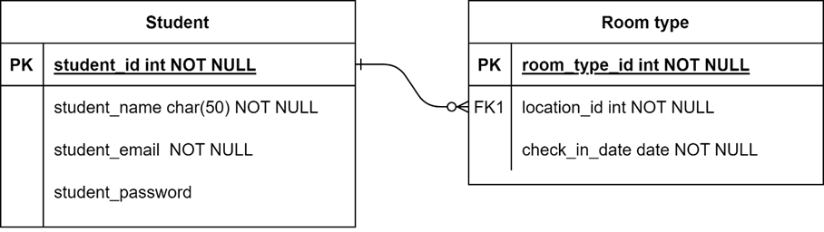
SYSTEM DESIGN

Slide 16
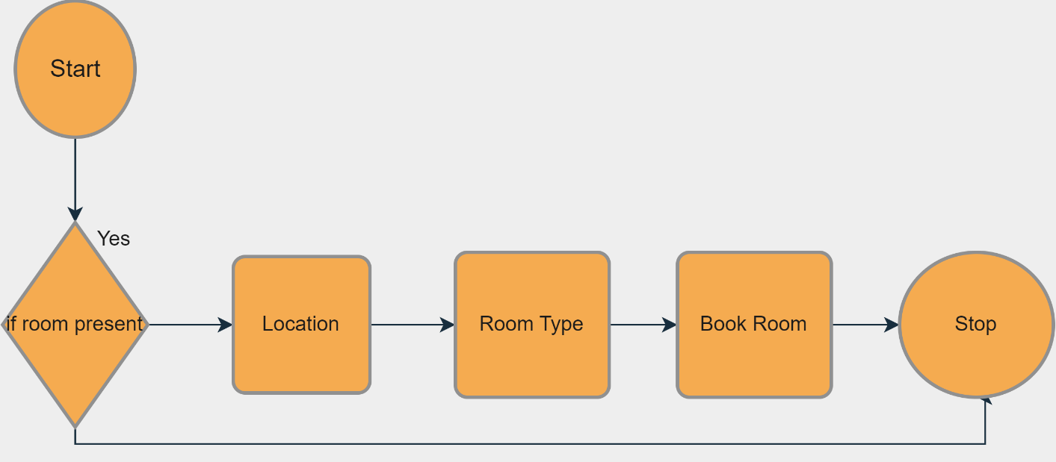
SYSTEM DESIGN cont..

Slide 17
IMPLEMENTATION
This system is easy to implement and use as it requires no intensive resources.

Slide 18
CONCLUSIONS
In summation, the system is now hosted and available for use by Patahostel Company and students.

Slide 19
RECOMMENDATIONS
System updates that also boost system performance are necessary to enhance user interface, reliability, and new technology.

Slide 20
REFERENCES
“• Kenya: University Enrollment 2017-2021 | Statista.” https://www.statista.com/statistics/1135785/university-enrollment-in-kenya/ (March 7, 2022).
“About :: Roometo.” https://roometo.com/about (March 10, 2022).
Chandra, Pooja. 2018. “A Study of Stress among Hostellers.” International Journal of Science and Research 8: 2319–7064. www.ijsr.net.
“Hostels a Big Problem in Higher Education - The Citizen.” https://www.thecitizen.co.tz/tanzania/magazines/success/hostels-a-big-problem-in-higher-education-2615654 (March 6, 2022).
“Most Preferred Student Accommodation in Nairobi - Qwetu.Co.Ke.” https://qwetu.co.ke/ (March 10, 2022).
Oluoch, Kelly, Miriam M Ndunge, and Alloys W Musuya. THE INFLUENCE OF AVAILABILITY OF COLLEGE HOSTEL ACCOMODATION FACILITIES ON STUDENTS’ ACADEMIC PERFORMANCE IN KENYA MEDICAL TRAINING COLLEGES IN WESTERN KENYA REGION. www.iprjb.org.
“Vuno Kejani.” https://apppage.net/preview/com.vunostore.test (March 10, 2022).

